Slide 1
CS174A Lecture 9

Slide 2
Announcements & Reminders
Midterm guide, book questions (no solutions), and sample questions available in Canvas
2/07/24&2/08/24 (Noon-1PM): Office hours, Zoom, not recorded
2/08/24: Midterm Exam: 6:00-7:30 PM PST, in person, in class
2/25/24: A3 due
Team project:
2/28/24: initial project proposals & teams due
3/01/24: midway demo

Slide 3
Last Lecture Recap
Rendering Pipeline:
Model space
Object/world space
Eye/camera space
Projection space
Screen space

Slide 4
Next Up
Geometric Calculations
Midterm: Feb 8, 6:00-7:30 PM PST
Hidden Surface Removal
Backface Culling
Object Space & Image Space Algorithms
Lighting
Flat and Smooth Shading

Slide 5
Transforming Lines & Planes
Transforming Lines
Given by 2 end points
Given by line equation y = mx + b
Transforming Planes
Given by 3 non-collinear points
Given by a plane equation: Ax + By + Cz + D = 0
Given by a normal and a point: n_{x}(x – p_{x}) + n_{y}(y – p_{y}) + n_{z}(z – p_{z}) = 0
If M_{point} is matrix to transform point, then M_{normal} = (M_{point}^{T})⁻¹
For orthonormal matrices, M^{T} = M⁻¹ implying M_{normal} = M_{point}

Slide 6
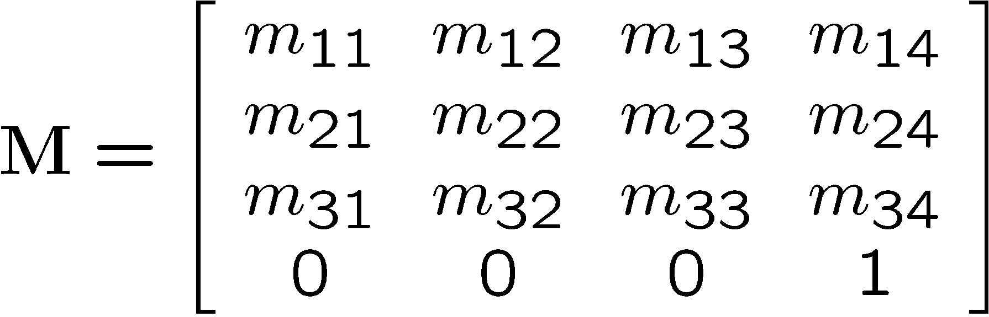
Orthonormal Matrices
Properties of Orthonormal Matrices
Consider upper-left 3x3 matrix
Each row is a unit vector
Each row is orthogonal to the others, i.e., their dot product = 0
These vectors can be rotated to align with the xyz-axis
Determinant = 1
Inverse of orthogonal matrix M⁻¹ = M^{T}
Preserves angles and lengths => rigid-body transformations
Examples of rigid-body transformations: translations, rotations

Slide 7
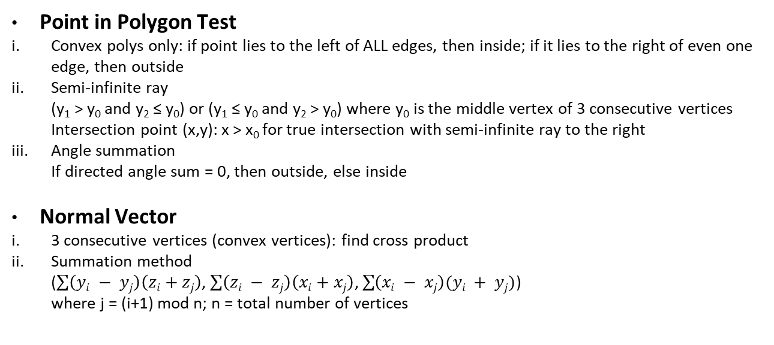
Geometric Calculations
Point in Polygon Test
Convex polys only: if point lies to the left of ALL edges, then inside; if it lies to the right of even one edge, then outside
Semi-infinite ray (y₁ > y₀ and y₂ ≤ y₀) or (y₁ ≤ y₀ and y₂ > y₀) where y₀ is the middle vertex of 3 consecutive vertices Intersection point (x,y): x > x₀ for true intersection with semi-infinite ray to the right
Angle summation If directed angle sum = 0, then outside, else inside
Normal Vector
3 consecutive vertices (convex vertices): find cross product
Summation method ($\sum{\left(yi − yj\right)\left(zi+zj\right)}$, $\sum{\left(zi − zj\right)\left(xi+xj\right)}$, $\sum{\left(xi − xj\right)(yi + yj)}$) where j = (i+1) mod n; n = total number of vertices

Slide 8

Geometric Calculations (Contd)
Plane Equation
Surface normal and distance from origin n_{x}x + n_{y}y + n_{z}z = d
3 points on plane n_{x}(x – x_{i}) + n_{y}(y – y_{i}) + n_{z}(z – z_{i}) = 0
On-Line Test P is on P₁P₂ means $\frac{x −x1}{y −y1}$ = $\frac{x2 −x1}{y2 −y1}$ If T_{1,2}(P) = (x – x₁)(y₂ – y₁) – (x₂ – x₁)(y – y₁) if +ve, P is on the right; if -ve, P is on the left
Edge-Edge Intersection P₁ and P₂ are on opposite sides of line defined by P₃P₄ and P₃ and P₄ are on opposite sides of line defined by P₁P₂ Equivalently, check for intersection: (T_{1,2}(P₃) * T_{1,2}(P₄) < 0) and (T_{3,4}(P₁) * T_{3,4}(P₂) < 0)

Slide 9

Geometric Calculations (Contd)
Collinearity Test t = distance from point P to line P₁P₂ θ = angle between P₁P and P₁P₂ t = |P₁P|sinθ = $\frac{\left|P1P\right||P1P2|sinθ}{|P1P2|}$ = $\frac{|P1P X P1P2|}{|P1P2|}$ if t < ϵ, P is considered to be on P₁P₂

